Slide 1
Zoom Meetings Primer
Columbia Engineering Alumni Association
March 18, 2020

Slide 2
Joining meetings via browser
Click or copy-paste the Board meeting link into your browser
If you’ve used Zoom before, skip straight to slide 6
Otherwise, keep reading…

Slide 3
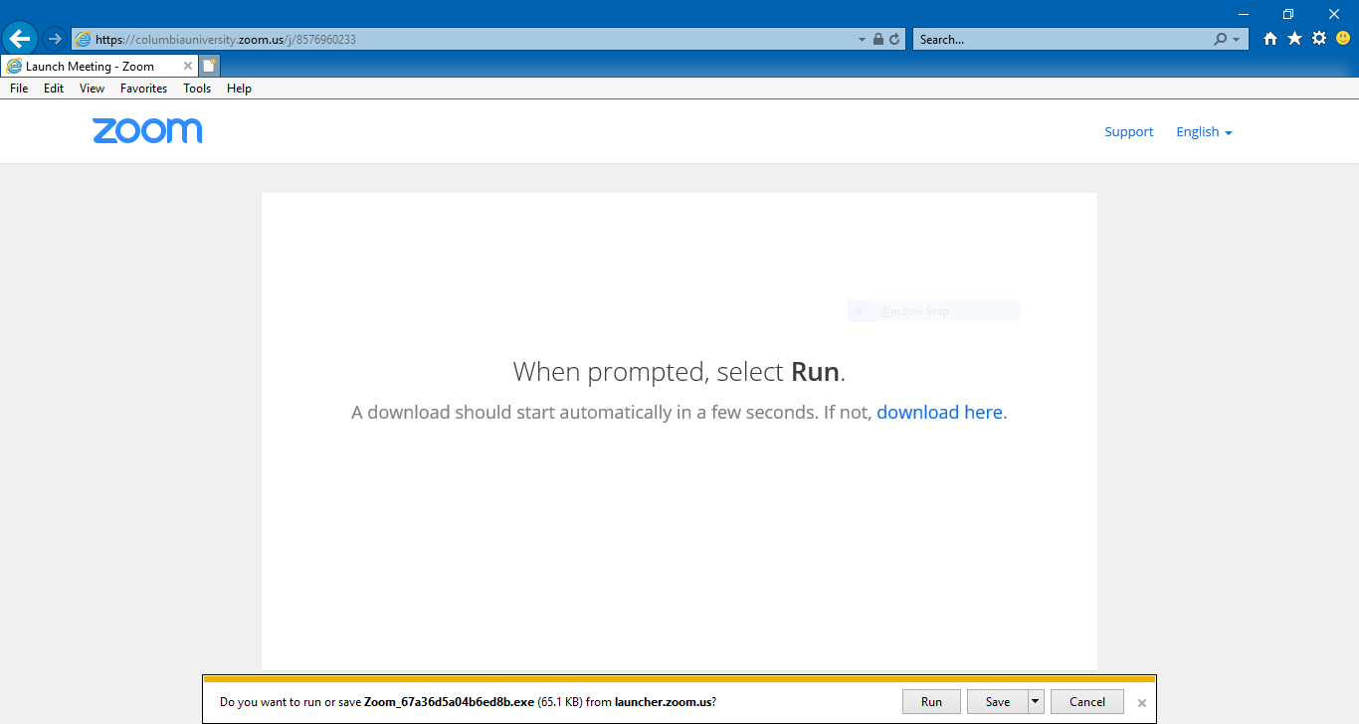
You’ll be prompted to run Zoom (circled in blue) so it can set itself up.
If your download doesn’t begin, click download here (circled in orange).

Slide 4

If you still can’t download, click join from your browser (circled in orange).
Though you’ll have fewer options participating this way, it’s a good option if your device won’t allow downloads.

Slide 5
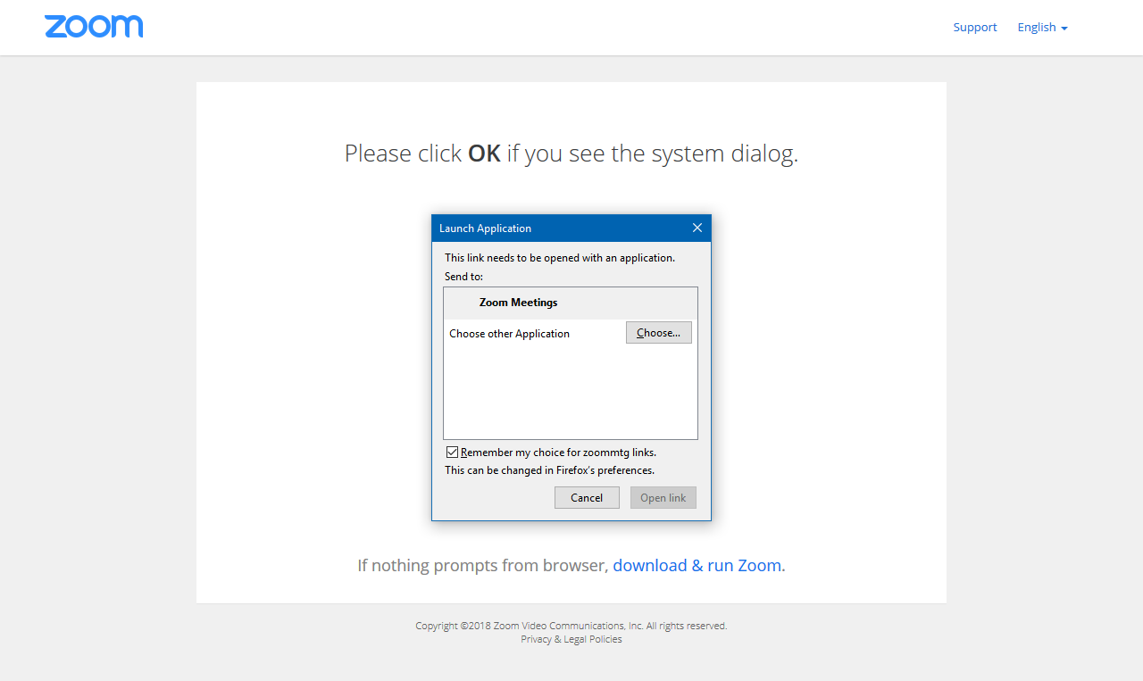
If asked what application to use, select Zoom Meetings (circled in blue).
Once you’ve selected it, click Open Link (circled in orange).

Slide 6
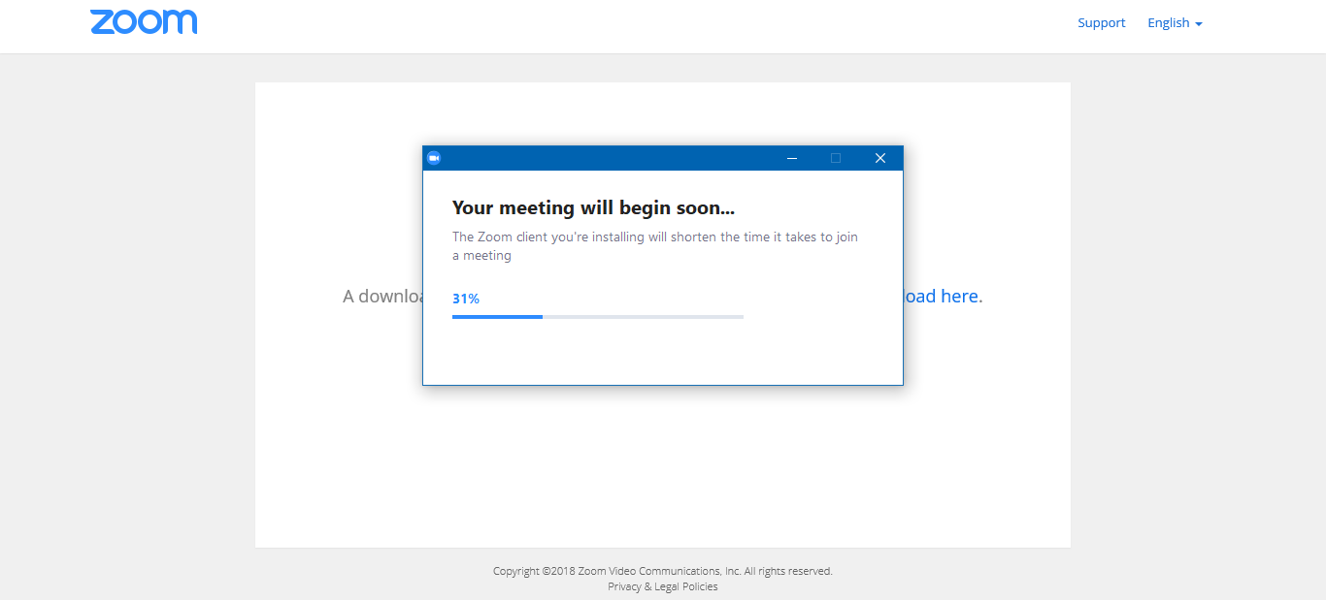
Let the setup wizard do its work (this may take a minute or two!)

Slide 7
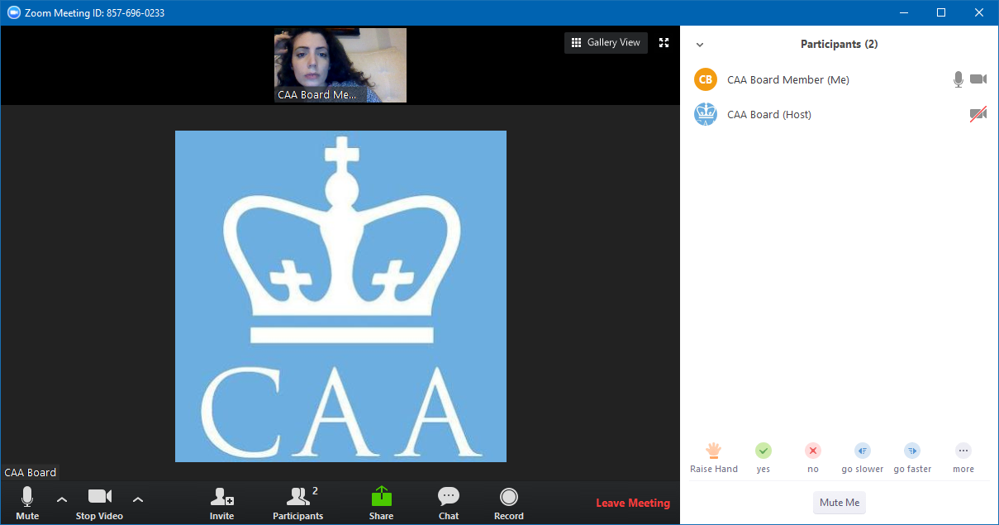
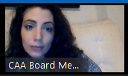
Once Zoom has launched, your system settings may automatically enable video (circled in blue) and audio (circled in orange).

Slide 8
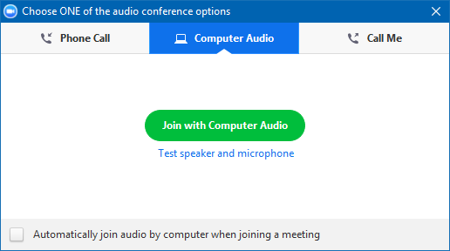
If your system doesn’t auto-select audio and video, you’ll see the below popup.
If you have headphones you can plug into your computer, click Computer Audio (circled in blue), then Join with Computer Audio (circled in orange).

Slide 9
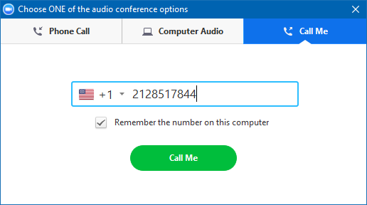
No headphones? Try using your phone by clicking Call Me (circled in orange).
Enter your own number in the space provided (circled in blue).
Finally, click Call Me (circled in orange).

Slide 10
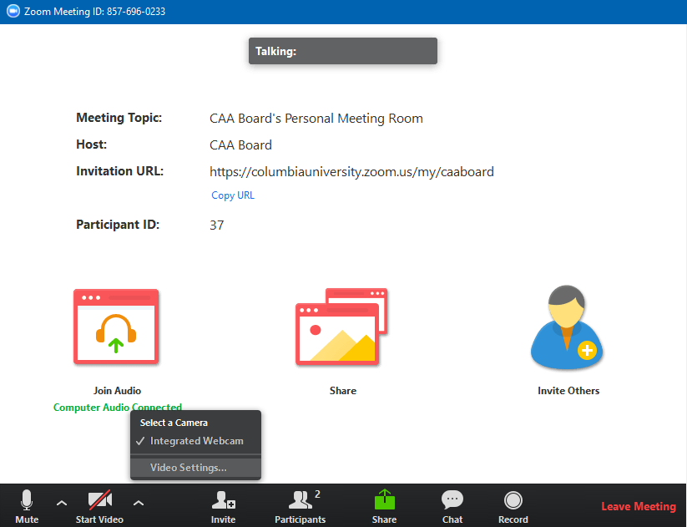
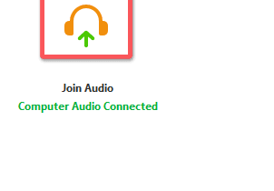
Now it’s time to enable video. Just click Start Video (circled in blue).

Slide 11
To turn video on and off, use camera icons (circled in blue).
To mute and unmute, use microphone icons (circled in orange).
If your icons disappear, mouse over where they should be to bring them back.

Slide 12
Looking for your Participants pane (circled in blue)?
To view, click Participants at the bottom center of your screen (circled in orange).

Slide 13
The Participants view (circled in blue) allows you to see who’s in the meeting.
This is also where you’ll find Raise Hand (circled in orange).

Slide 14
To send a message, click Chat (circled in blue).
You can also chat 1:1 by clicking individual participant names (circled in orange).

Slide 15
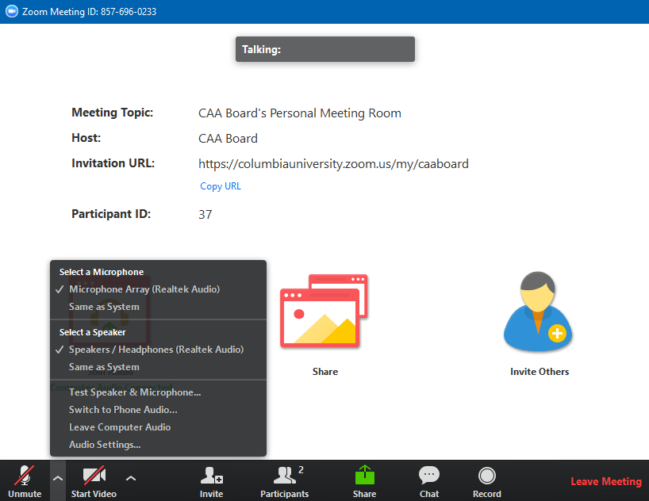
Trouble hearing or being heard? Try a different audio option.
Open the audio menu (circled in blue).
There, select Switch to Phone/Computer Audio (circled in orange).

Slide 16
If you are switching to computer audio because your phone connection is bad…
Click Computer Audio (circled in blue).
Then click Join with Computer Audio (circled in orange).
Make sure you have a pair of headphones plugged in!

Slide 17
If you are having trouble hearing or talking via your computer…
Switch to your phone by clicking Call Me (circled in orange).
Enter your own number in the space provided (circled in blue).
Next, click Call Me (circled in orange).

Slide 18

Joining meetings via Zoom app
https://columbiauniversity.zoom.us/j/582613245
https://columbiauniversity.zoom.us/j/582613245
Clicking the CAA Board meeting room link (https://columbiauniversity.zoom.us/j/582613245) should trigger your Zoom app to add you to the meeting.

Slide 19
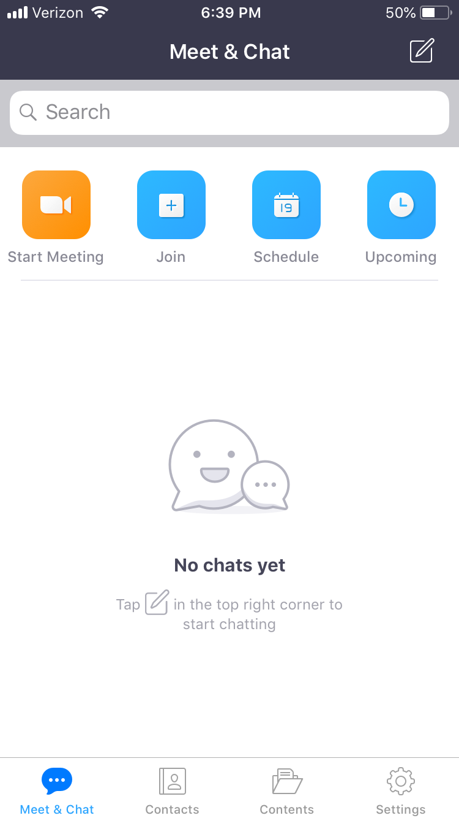
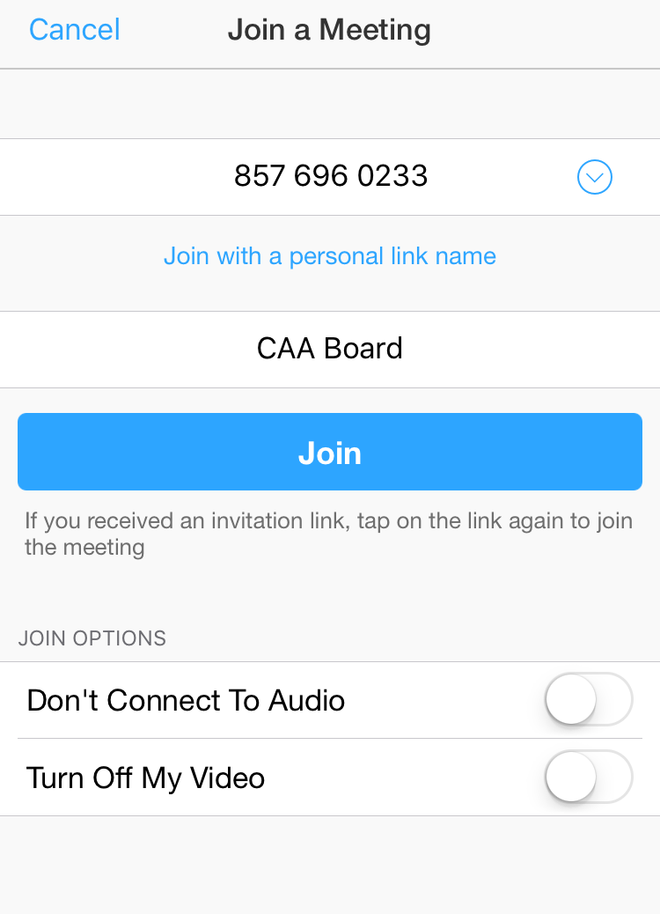
Or, open your app and click Join (circled in blue).
Enter the Meeting ID as shown (circled in orange).

Slide 20
Take a moment to review the items circled in blue:
Check your name, especially on shared devices
Set Don’t Connect To Audio switch to off, as shown
Set Turn Off My Video switch to off, as shown
When done, click Join (circled in orange).

Slide 21
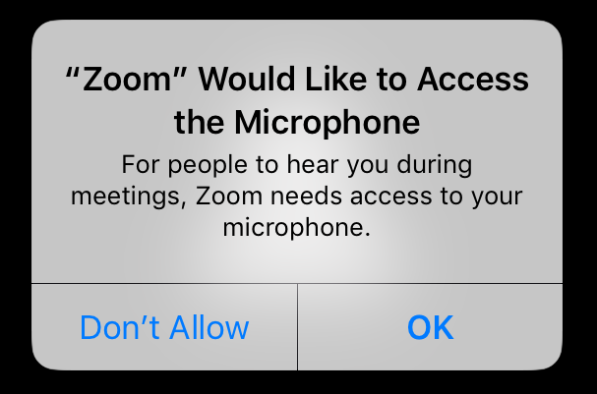
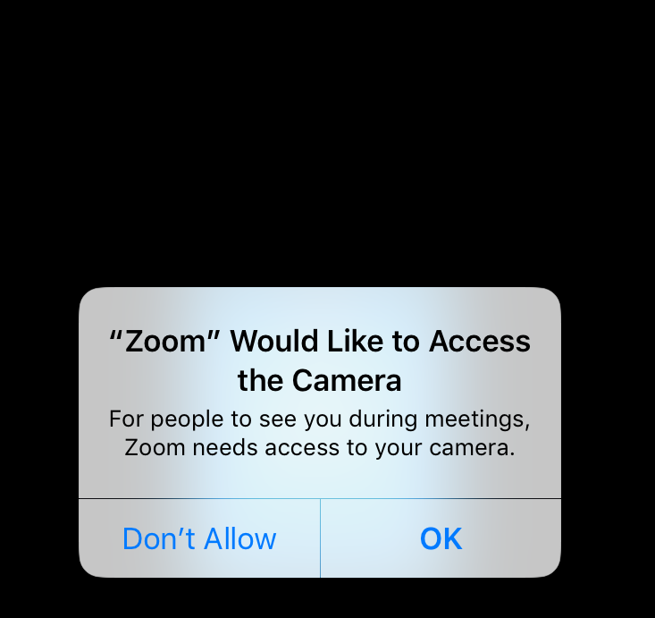
If prompted, give Zoom access to your device’s microphone (circled in blue) and camera(circled in orange).

Slide 22
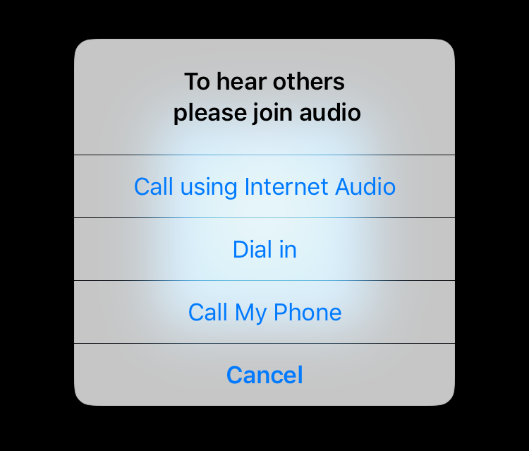
You may be prompted to join audio via Internet Audio (circled in blue) or Call My Phone (circled in orange).

Slide 23
If you select Internet Audio (circled in blue), you’ll join the conference right away.
Make sure you have headphones plugged into your phone to prevent feedback!

Slide 24
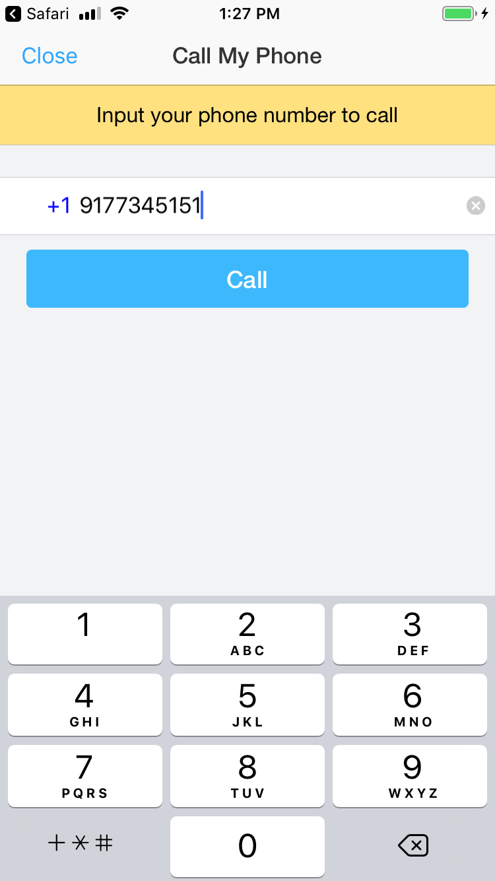
If you select Call My Phone:
Enter your own number in the field provided (circled in blue)
Click Call (circled in orange).

Slide 25
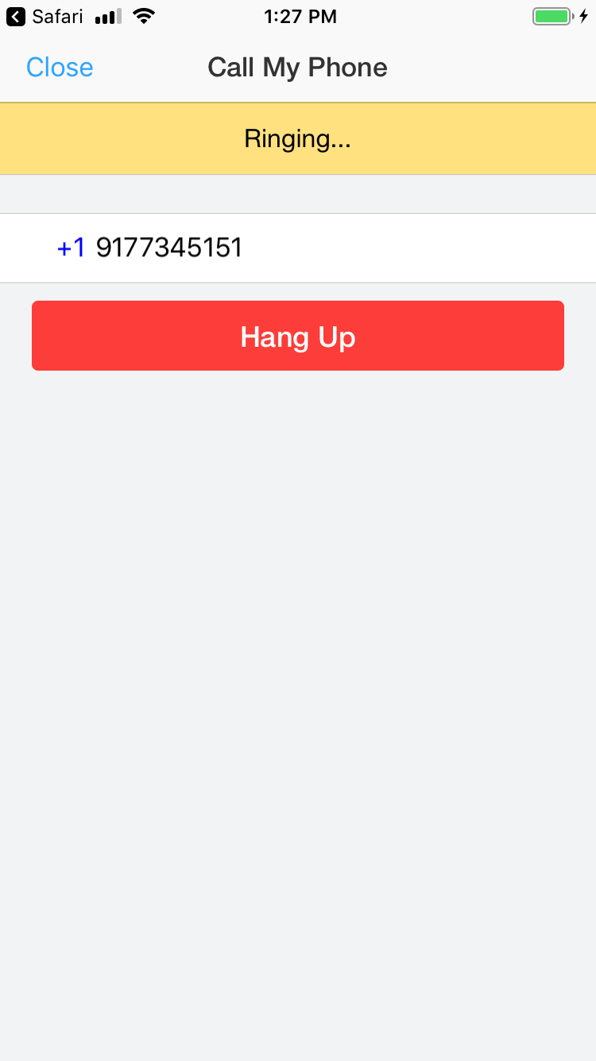
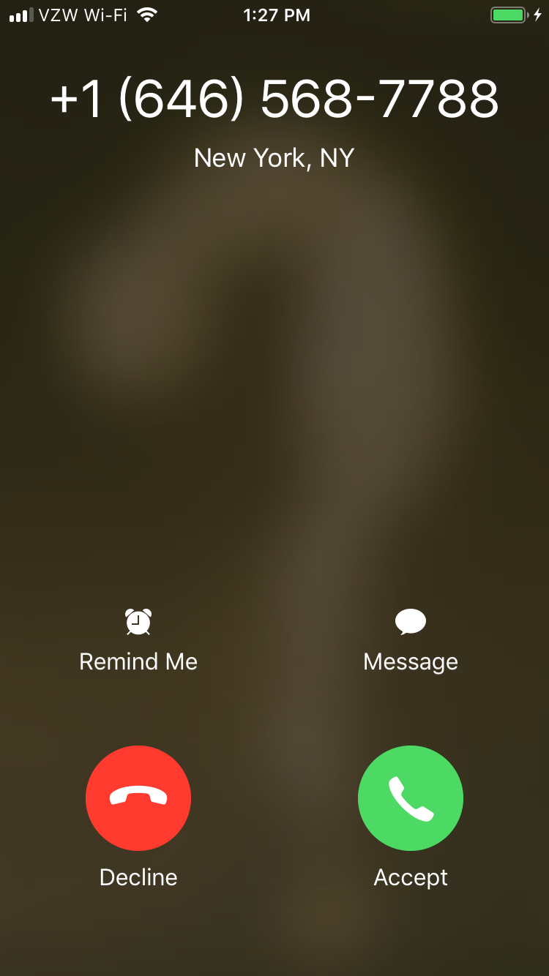
You’ll see a “Ringing” screen before receiving a call from a local number.
Pick up and Zoom will place you in the conference!

Slide 26
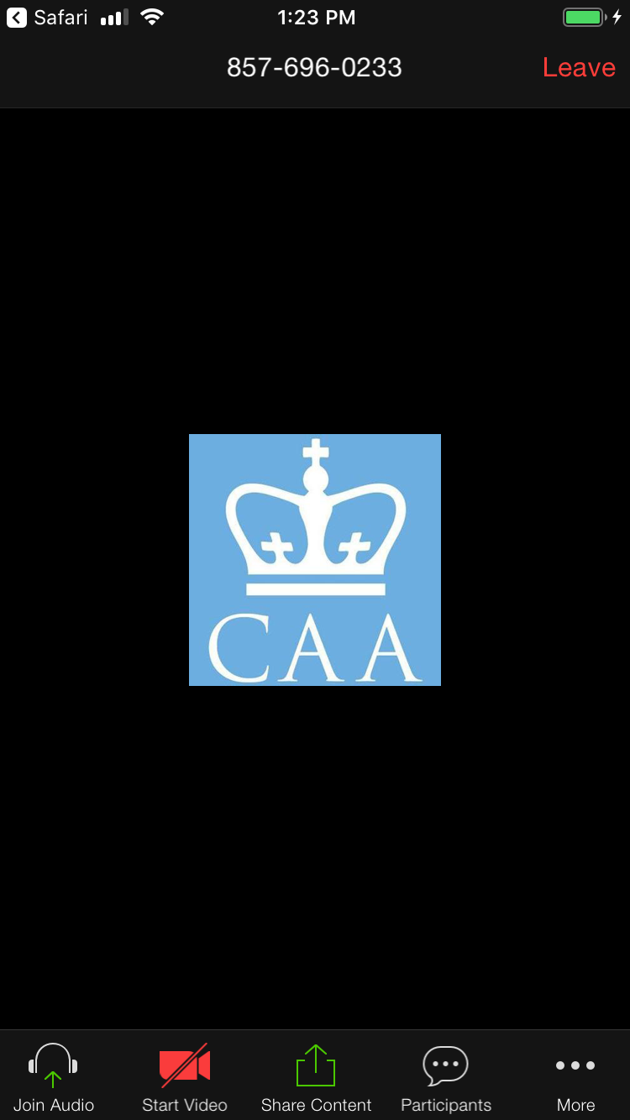
If your icons (circled in blue) vanish during the call, just tap your screen to bring them back.
Use them to mute/unmute and start/stop video (circled in orange).

Slide 27
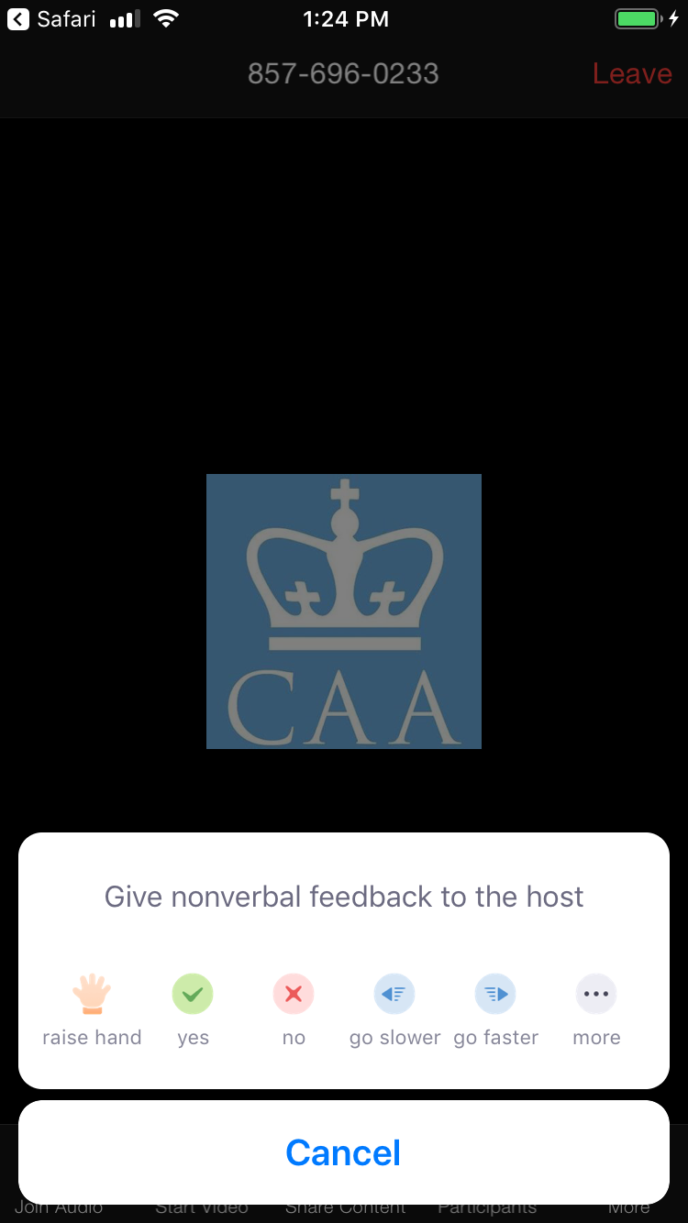
Use icons to Raise Hand. First, click More (circled in blue).
The resulting menu includes Raise Hand (circled in orange).

Slide 28
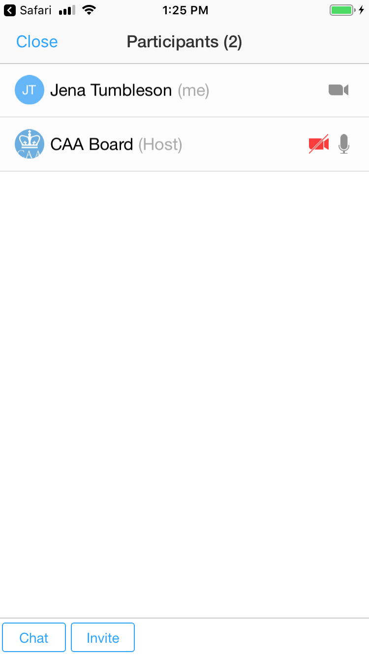
Participants is also in icons (circled in blue).
In addition to showing you who’s joined, you can Chat (circled in orange).

Slide 29
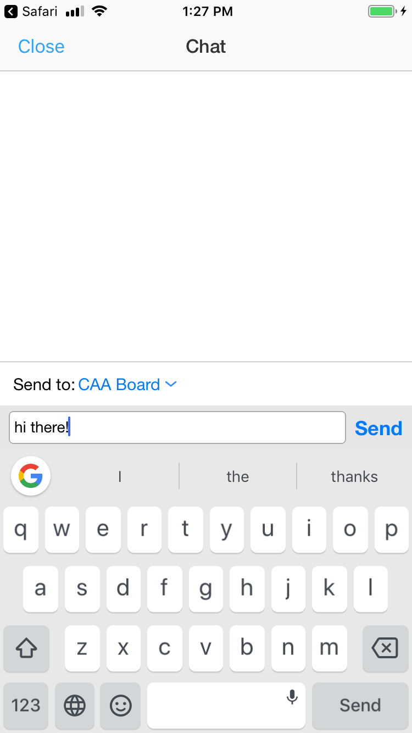
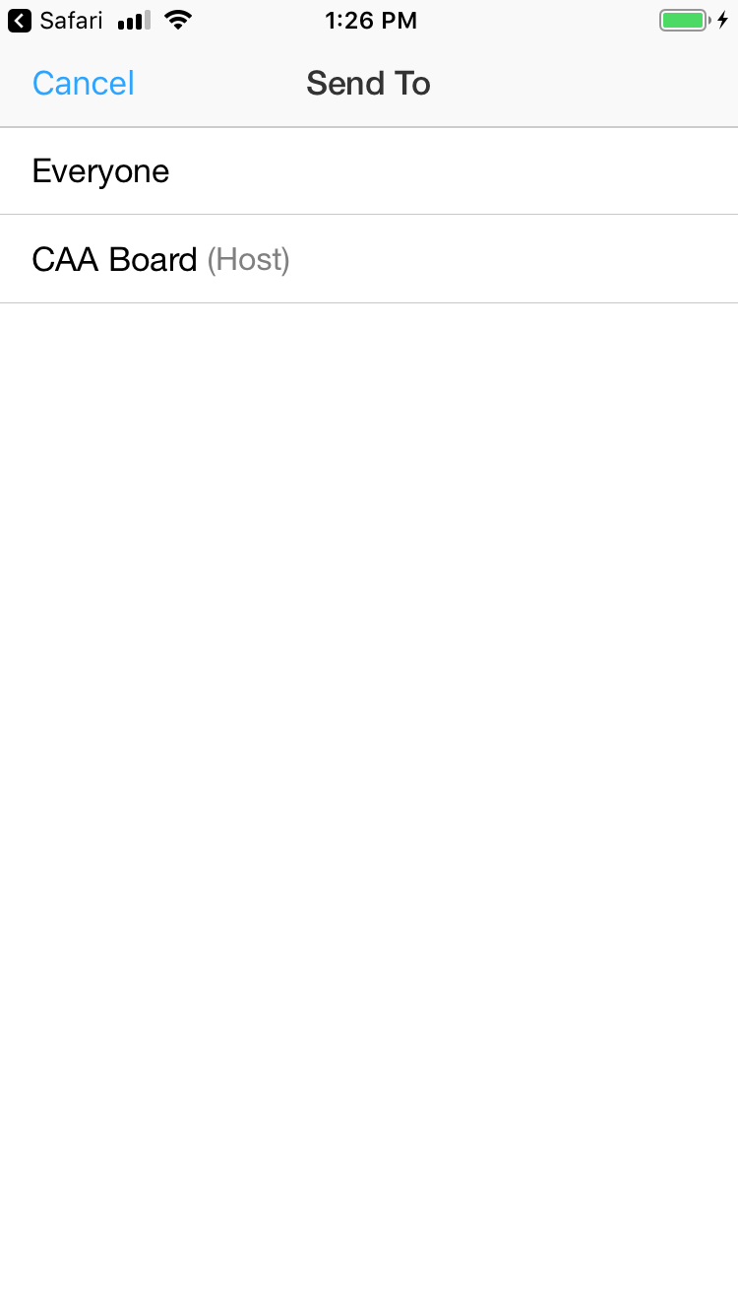
Chat lets you send comments to the group or individuals. Click Send To (circled in blue) to change the recipient.
Click the new recipient(s) to select (circled in orange).

Slide 30
Zoom can even help you look your best on camera! Before the meeting, open your app and select Settings (circled in blue).

Slide 31
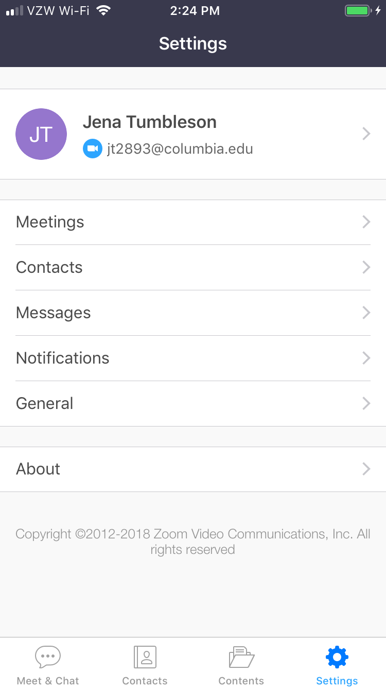
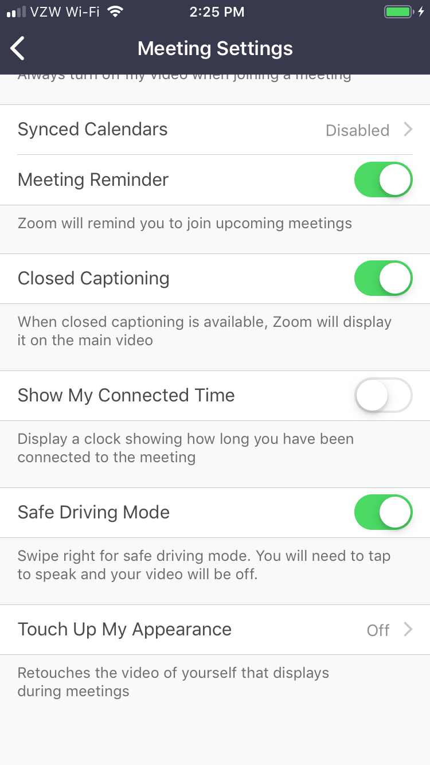
In Settings, select Meetings (circled in blue).
In Meetings, select Touch Up My Appearance (circled in orange), at the bottom of the menu.

Slide 32
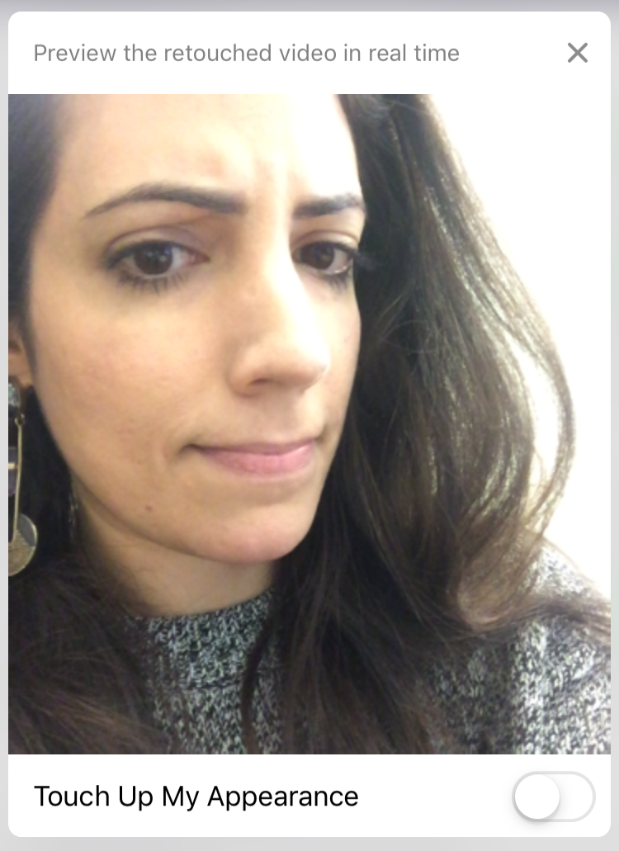
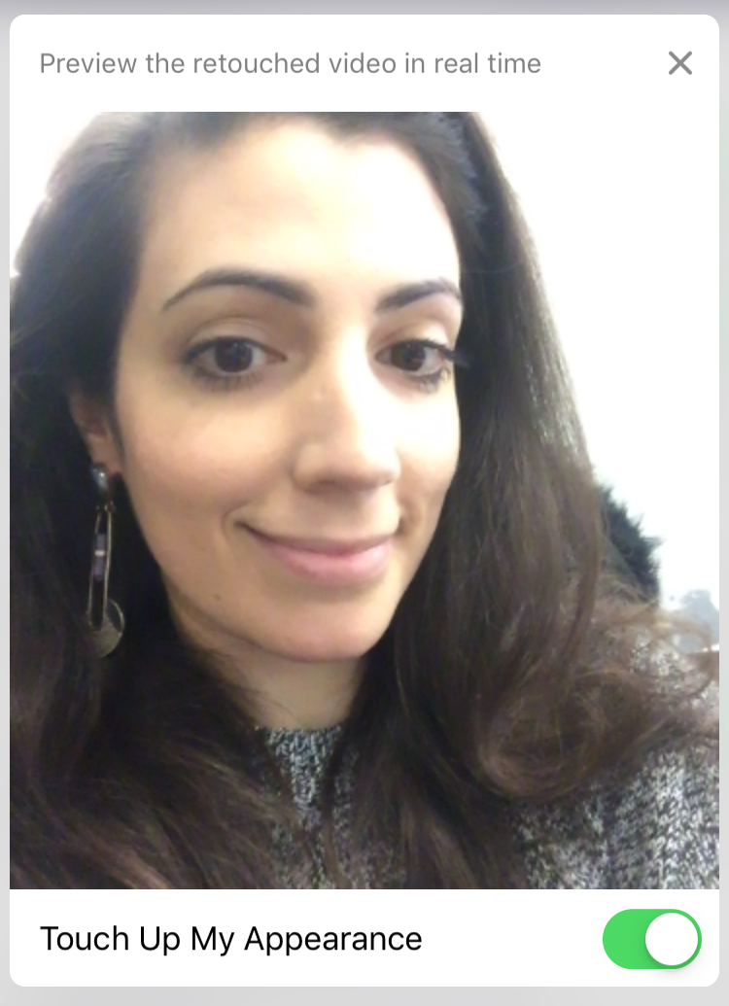
Toggle the Touch Up button (circled in blue) to see results in real time.
At left, without
Touch Up
☹
And at right, with
Touch Up!
☺

