Slide 1
Discourse Relation Parsing
Natural Language Processing LaB @Columbia University
By Duaa Tariq

Slide 2

Introduction:
Background: Discourse relation parsing is a research area in Natural Language Processing focusing on analyzing discourse structures by identifying different types of discourse relations (in a spoken or written text).
Previous Research: The STAC data set (Asher, 2016) is an annotated multi-party chat log for an online game.
Project Goals:
- Contribute a dataset consisting of discourse relations annotated for long dialogues, specifically transcripts of TV show episodes.
- Apply knowledge of discourse relation recognition and link prediction to the task
- Research and use tools to effectively complete annotations
- Analyze frequencies of defined relation labels, identify new challenges and relation types

Slide 3
Method:
Episodes- TV show episodes from the Forever Dreaming collection (Chen & Chu, 2022). Sample size will consist of 1000 episodes.
More- Research tools, previous publications (ex: STAC corpus for an annotation trial)
Annotate- Define the discourse relations prior to the process. Annotate the spoken dialogues in the transcript using Inception, an online web application.
Revise- Revise and redefine the type of discourse relations relevant for the sample. Identify and fix any errors overseen during annotation process.
Understand- Numerically record and analyze the results. Explore further steps and ideas.

Slide 4
Incoming relations
i - n… ,i - 3 ,i - 2 ,i - 1 —--> i —--> i + 1
EDUs (elementary discourse units) are any meaningful part of an utterance or statement. Discourse relations will be incoming meaning based on previous EDUs (i-1). Relations do not have to be adjacent and can be linked to any previous EDU.

Slide 5
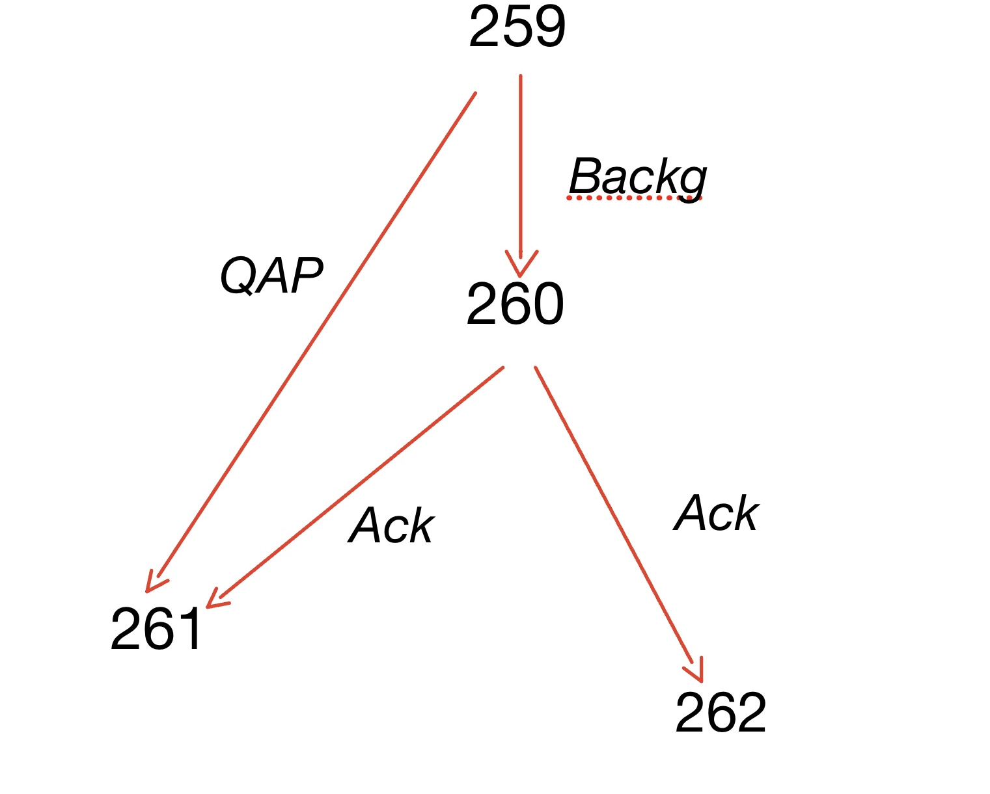
Example:
259 R: Isn’t this amazing?
260 R: I mean, I have never made coffee before in my entire life
261 C: That is amazing.
262 J: Congratulations.

Slide 6
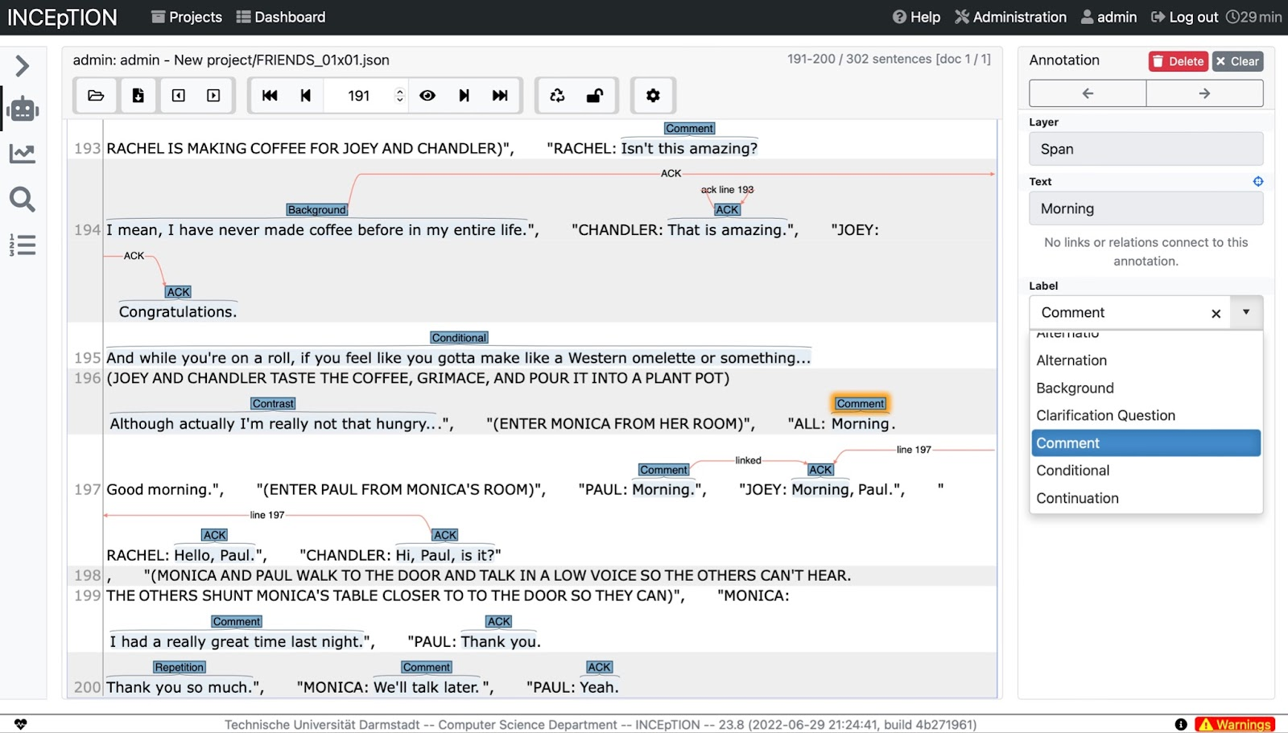
Inception

Slide 7
RESULTS: Frequencies of Relations in Example Episode
Relation Type | #
Comment | 68
Continuation | 53
Acknowledgment | 49
Question-Answer Pair | 35
Elaboration | 24
Clarification Question | 21
Background | 21
Contrast | 18
Explanation | 17
Q-Elab | 17
Repetition | 16
Present Narration | 12
Parallel | 12
Alternation | 10
Rhetorical Question | 10
Narrate-Elab | 7
Conditional | 4
Recount Narration | 3
Correction | 2
Interruption | 2
Total | 409

Slide 8
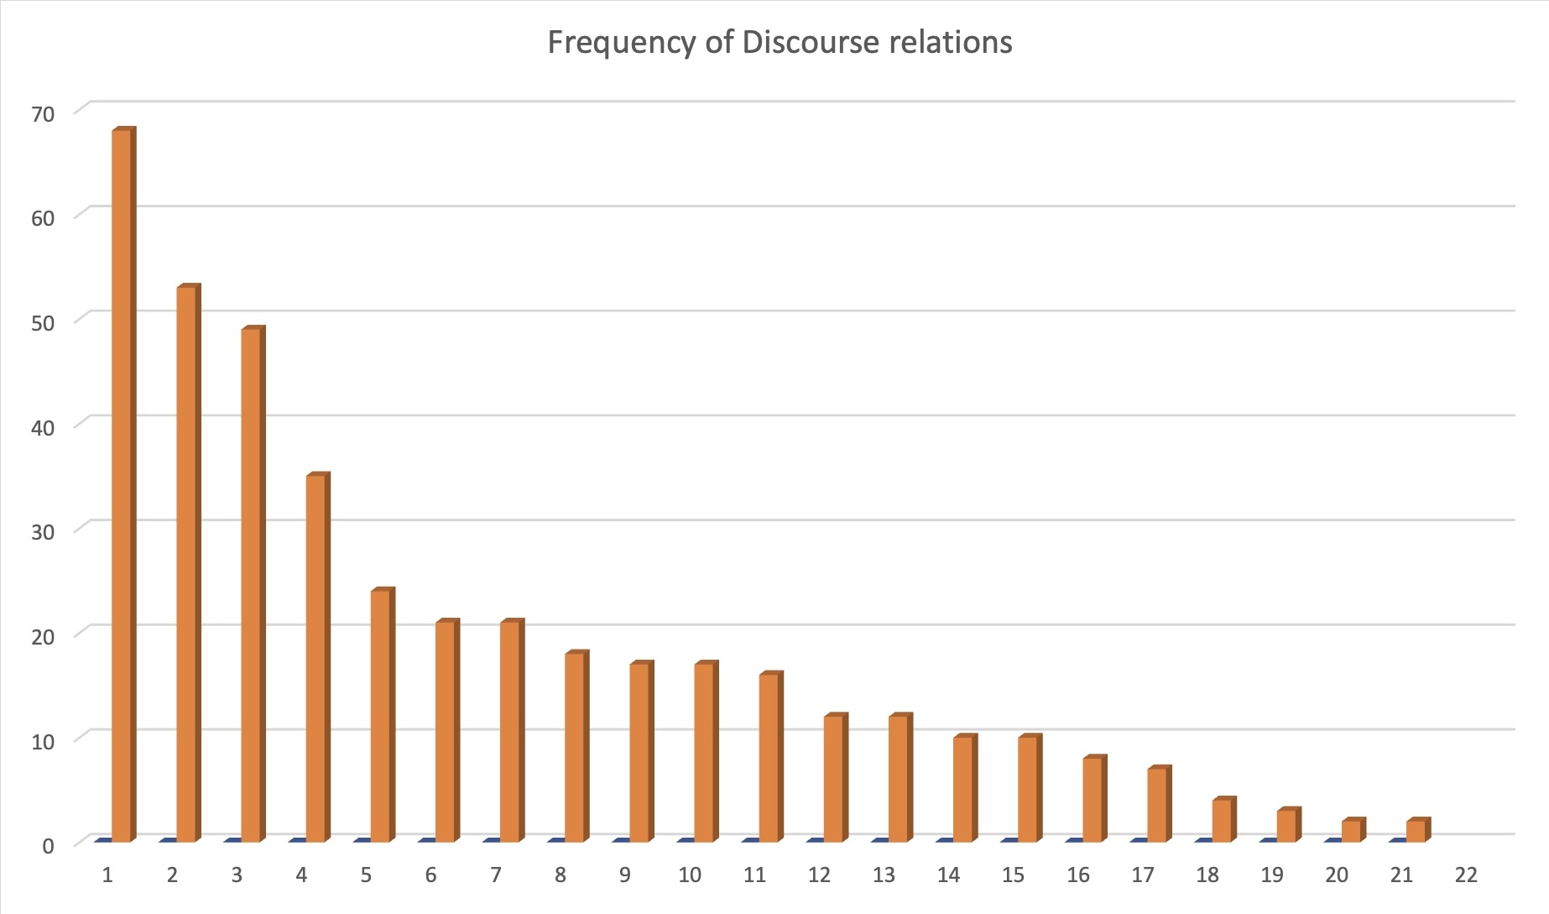
Number of occurrences
Relation Type
Relations are labelled from 1 (“comment”) to 21 (“interruption”)

Slide 9
Analysis:
Observations:
In long dialogues, ”comment” , “continuation” and “acknowledgement” are the most frequent relations due to consistent conversation between characters.
“correction” and “interruption” are rare occurrences in the example episode, likely due to chance.
Each scene begins with “comment” since they are usually unrelated to previous EDUs.
“repetition” and “rhetorical question” are new relations due to the added use of rhetoric in TV episodes (entertainment).
“repetition” and “acknowledgement” were picked up by Inception and became predictable.
Challenges:
STAC has players focused on one objective, which was the game. TV episodes consists of a variety of scenarios.
TV shows are multi-modal, so it is more difficult to detect sarcasm (or tone of the speaker) from just the written text
The STAC corpus consisted of chat only, whereas there is a lot more action and spontaneity (resulting in interruption, etc.) on TV shows.
Instances where characters speak on the phone, and you can only assume what the other person is saying. One-sided utterances are still a part of the dialogue.

Slide 10
Future Work
Friends is a limited genre, so a variety of shows and episodes are needed.
Larger sample size of at least 1000 episodes.
Relations may still need to be redefined, multiple relations for single utterances should be explored.

Slide 11

Acknowledgements/References
Mentor: Yilun (Bobby) Hua
PI: Professor Kathleen McKeown
Resources:
Tools- Inception: Technische Universität Darmstadt -- Computer Science Department -- INCEpTION -- 23.8 (2022-06-29 21:24:41, build 4b271961
Forever Dreaming Transcripts: Chen, M., Chu, Z., Wiseman, S., & Gimpel, K. (2022, June 6). SummScreen: A dataset for abstractive screenplay summarization. arXiv.org. Retrieved July 28, 2022, from https://arxiv.org/abs/2104.07091
STAC data set: Asher, N., Hunter, J., Morey, M., Farah, B., & Afantenos, S. (n.d.). Discourse structure and dialogue acts in multiparty dialogue: The stac corpus. ACL Anthology. Retrieved July 28, 2022, from https://aclanthology.org/L16-1432/
Li, J., Liu, M., Qin, B., & Liu, T. (2022, January 20). A survey of discourse parsing - frontiers of computer science. SpringerLink. Retrieved July 28, 2022, from https://link.springer.com/article/10.1007/s11704-021-0500-z
Shi, Z., & Huang, M. (n.d.). A deep sequential model for discourse parsing on multi-party dialogues. Proceedings of the AAAI Conference on Artificial Intelligence. Retrieved July 28, 2022, from https://ojs.aaai.org/index.php/AAAI/article/view/4680

